Slide 1
CS539 Final Project
Gabrielle Cabebe, Adityavikram Gurao, Uday Kumbhar, Agustina Maccio, Tess Royds
SPOTIBILITY
SPOTIBILITY
SPOTIBILITY
SPOTIBILITY
SPOT A FRIEND
Notes:
For making presentation:
Intro
Motivation (Tess)
Description of data (Gabby)
Preprocessing (Agus)
K-mean model (Tess)
Limitations/Future Work (Ady)
Any Questions?, Thank you :)

Slide 2

MOTIVATION
MUSIC HAS THE POWER TO BRING PEOPLE TOGETHER
We have researched the use of clustering techniques to generate ‘friendships’ based on musical preferences and playlist composition of Spotify users.

Slide 3
Infrastructure
API
Model
Visualization
Data Pre Processing
K-Means
User1
User2
Scraping Data
Feature Selection
Elbow Method
K-Means Model
Saving Model
Reusing it
Validation
Recommend
Playlist Link
Web plot of features from that playlist
Recommended playlist Link
Web Plot

Slide 4
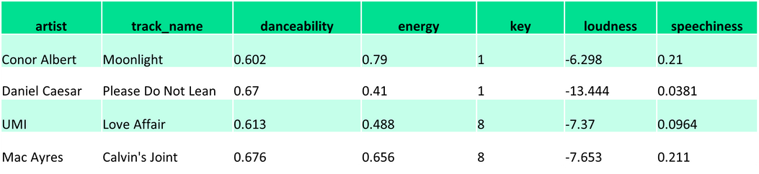
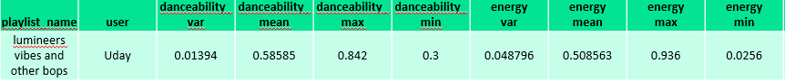

Data & Feature Engineering
We collected 252 playlists.
13 Spotify audio features were obtained per song in each playlist.
Playlist
New representation
nxp matrix
p = 13 features
1xp vector
p = 13 features x 4 (var, mean, min, max)
New dataset:
rows: playlist as a vector
columns: var, mean, min and max value
of each original feature
Normalization & PCA

Slide 5
DBSCAN
Various principal components and parameters were tested, but either 1 cluster dominated the others, or a majority of playlists were considered outliers.
OPTICS
Too many playlist were considered as outliers.
Notes:
parameters tested: epsilon, minimum number of samples per cluster

Slide 6
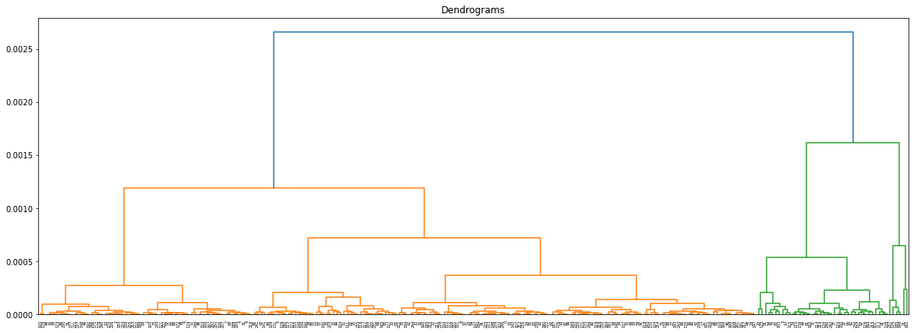
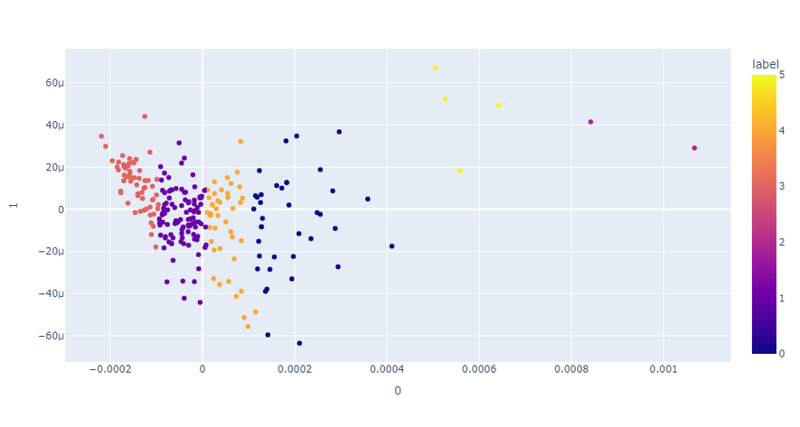
HIERARCHICAL
CLUSTERING
Agglomerative
CHOOSING THE OPTIMAL K
Based on Dendrogram
We chose six after examining the plotted data.
SILHOUETTE SCORE:0.448

Slide 7
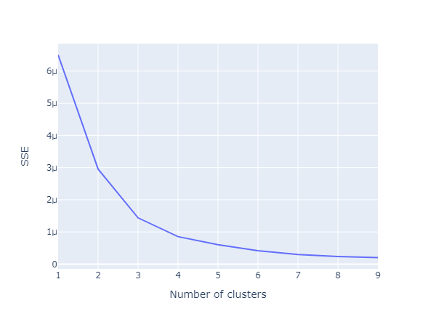
K Means
CHOOSING THE OPTIMAL K
Based on the elbow method, optimal K is four.
We chose six after examining the plotted data.

Slide 8
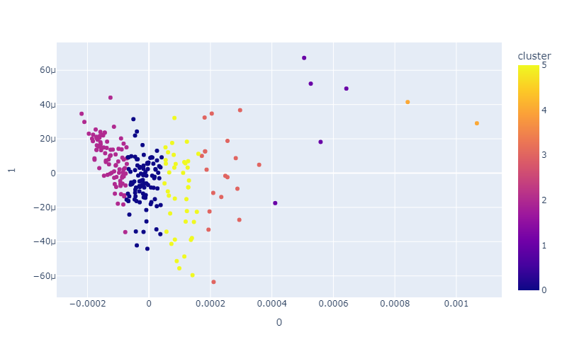
K Means
SILHOUETTE SCORE: 0.999

Slide 9
SPOTIFY API
Fetching a maximum of 100 songs in a playlist.
Limitations
DATA COLLECTION
Limitations
Limited amount of data.
Limitations
MODEL
Limitations
We have used traditional machine learning techniques
There is no ground truth

Slide 10

SPOTIBILITY
SPOTIBILITY
SPOTIBILITY
SPOTIBILITY
FUTURE SCOPE
Gathering more data.
Take advantage of deep learning techniques.

Slide 11
THANK YOU
THANK YOU
THANK YOU
THANK YOU
DEMO

